Slide 1


BTT
Sales and Services
Release Management Plan
Krishna Krupal

Slide 2
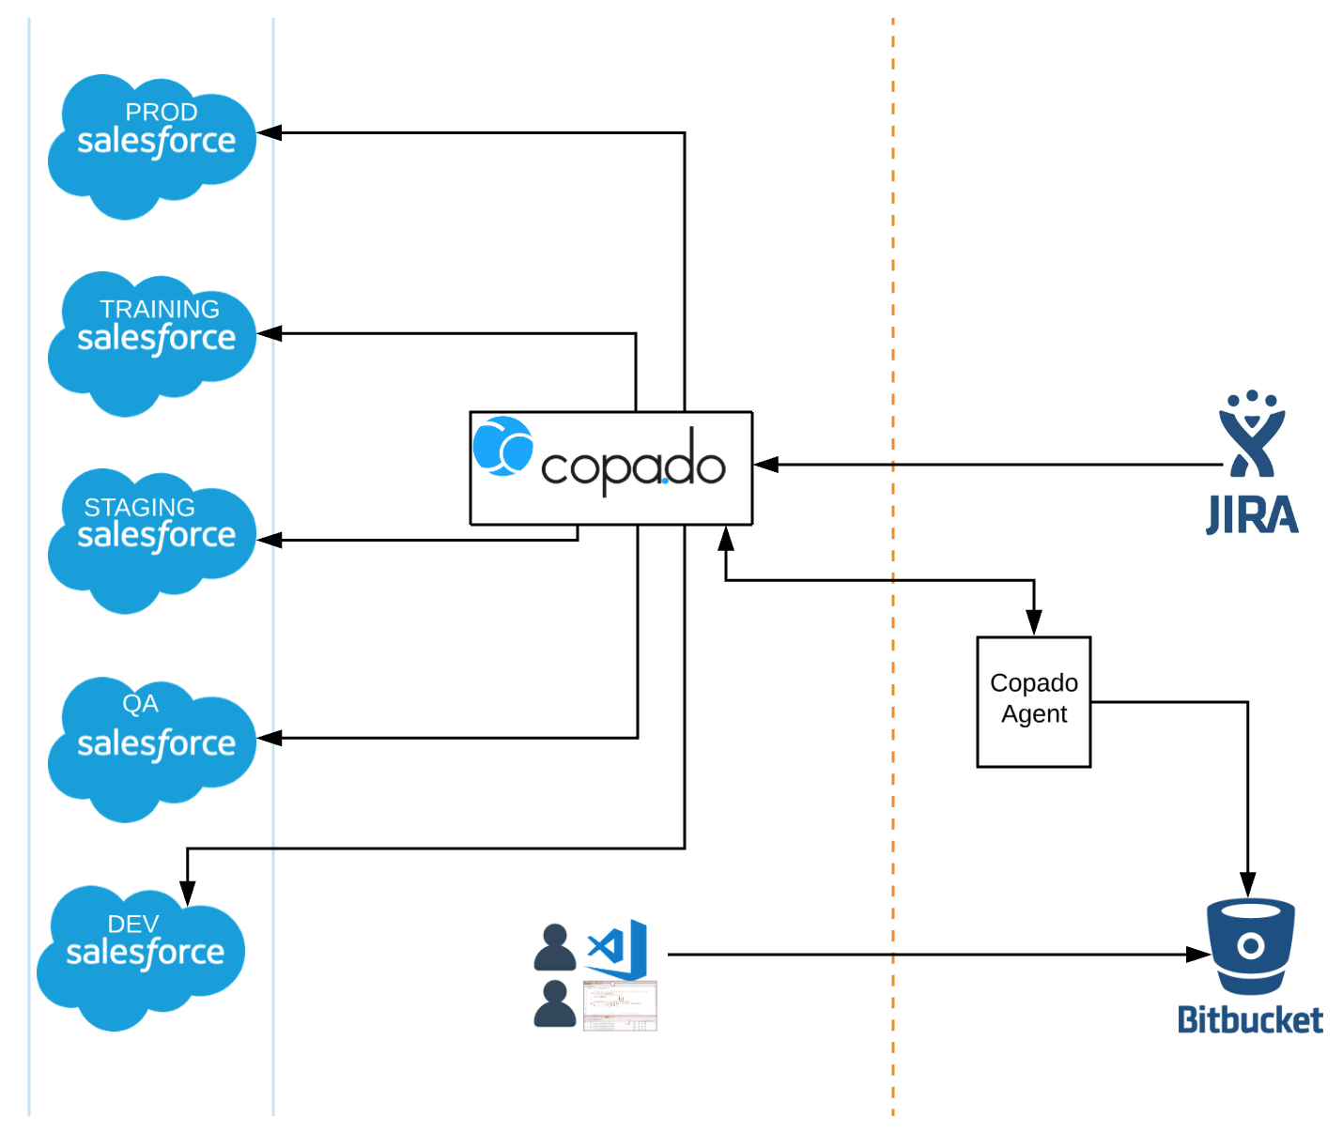
Release Management Setup

Slide 3
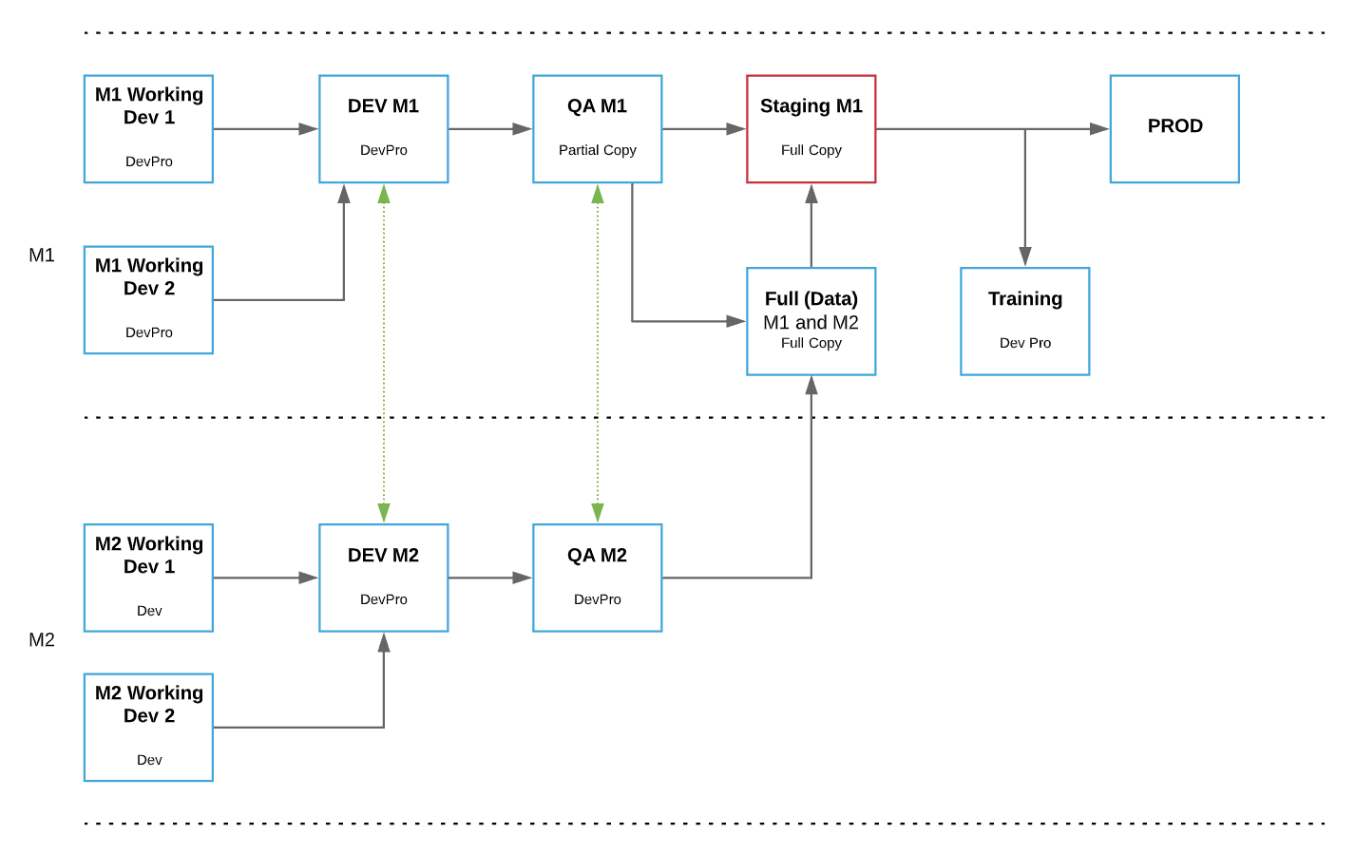
Environment Setup

Slide 4
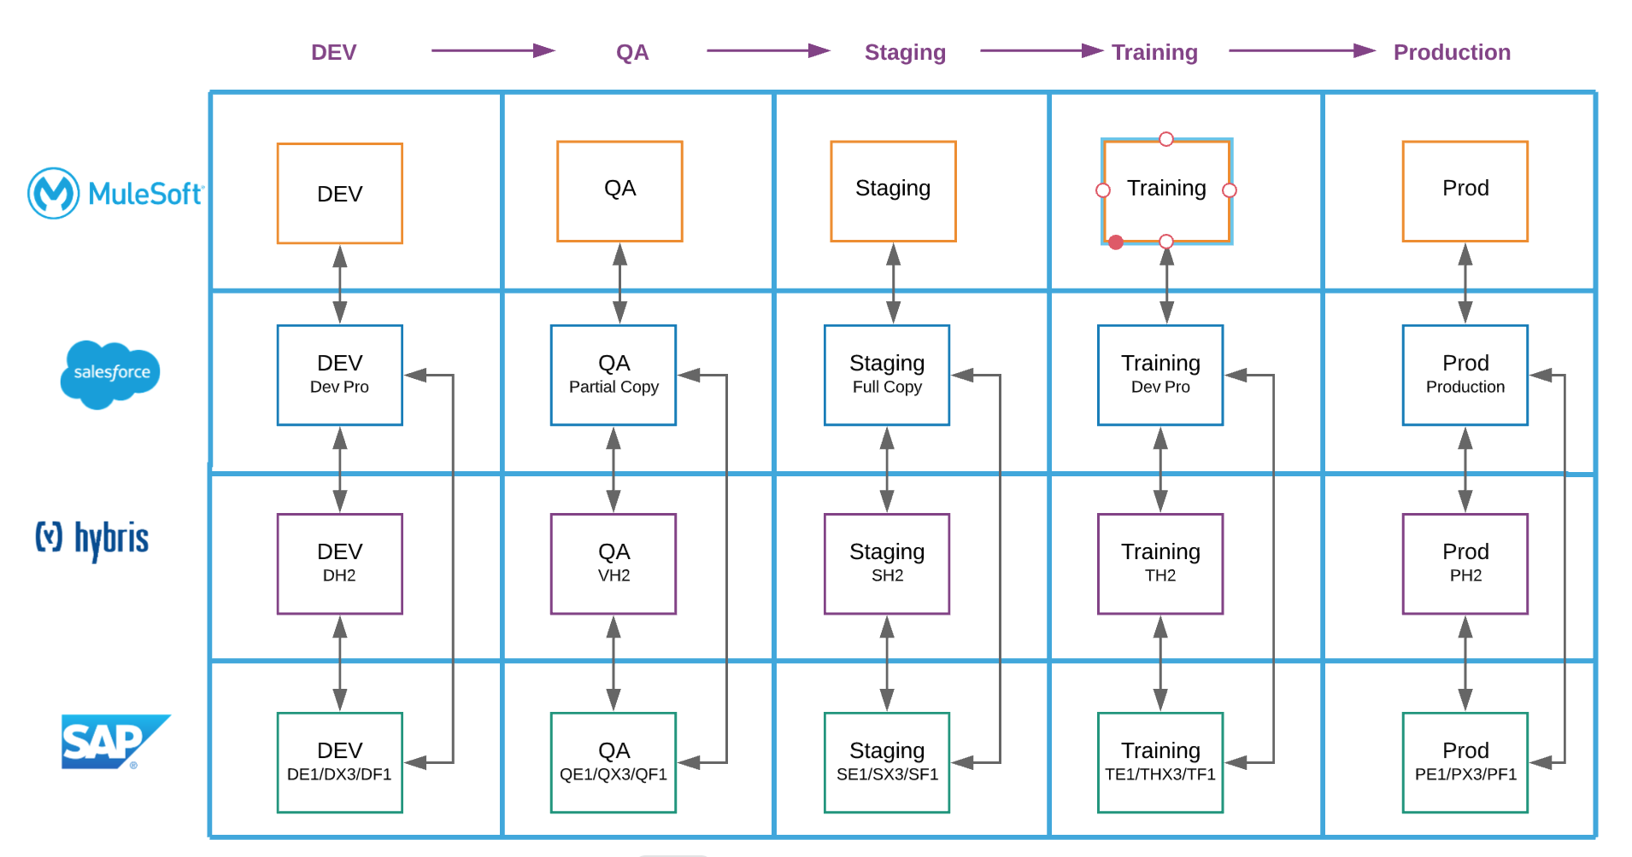
Environment Mapping
Notes:
Apache Server:
Dev:
QA: We haven't decided where the QA server is going to be
Staging: New servers. Not procured
Training: Existing training server
Production: Not procured

Slide 5
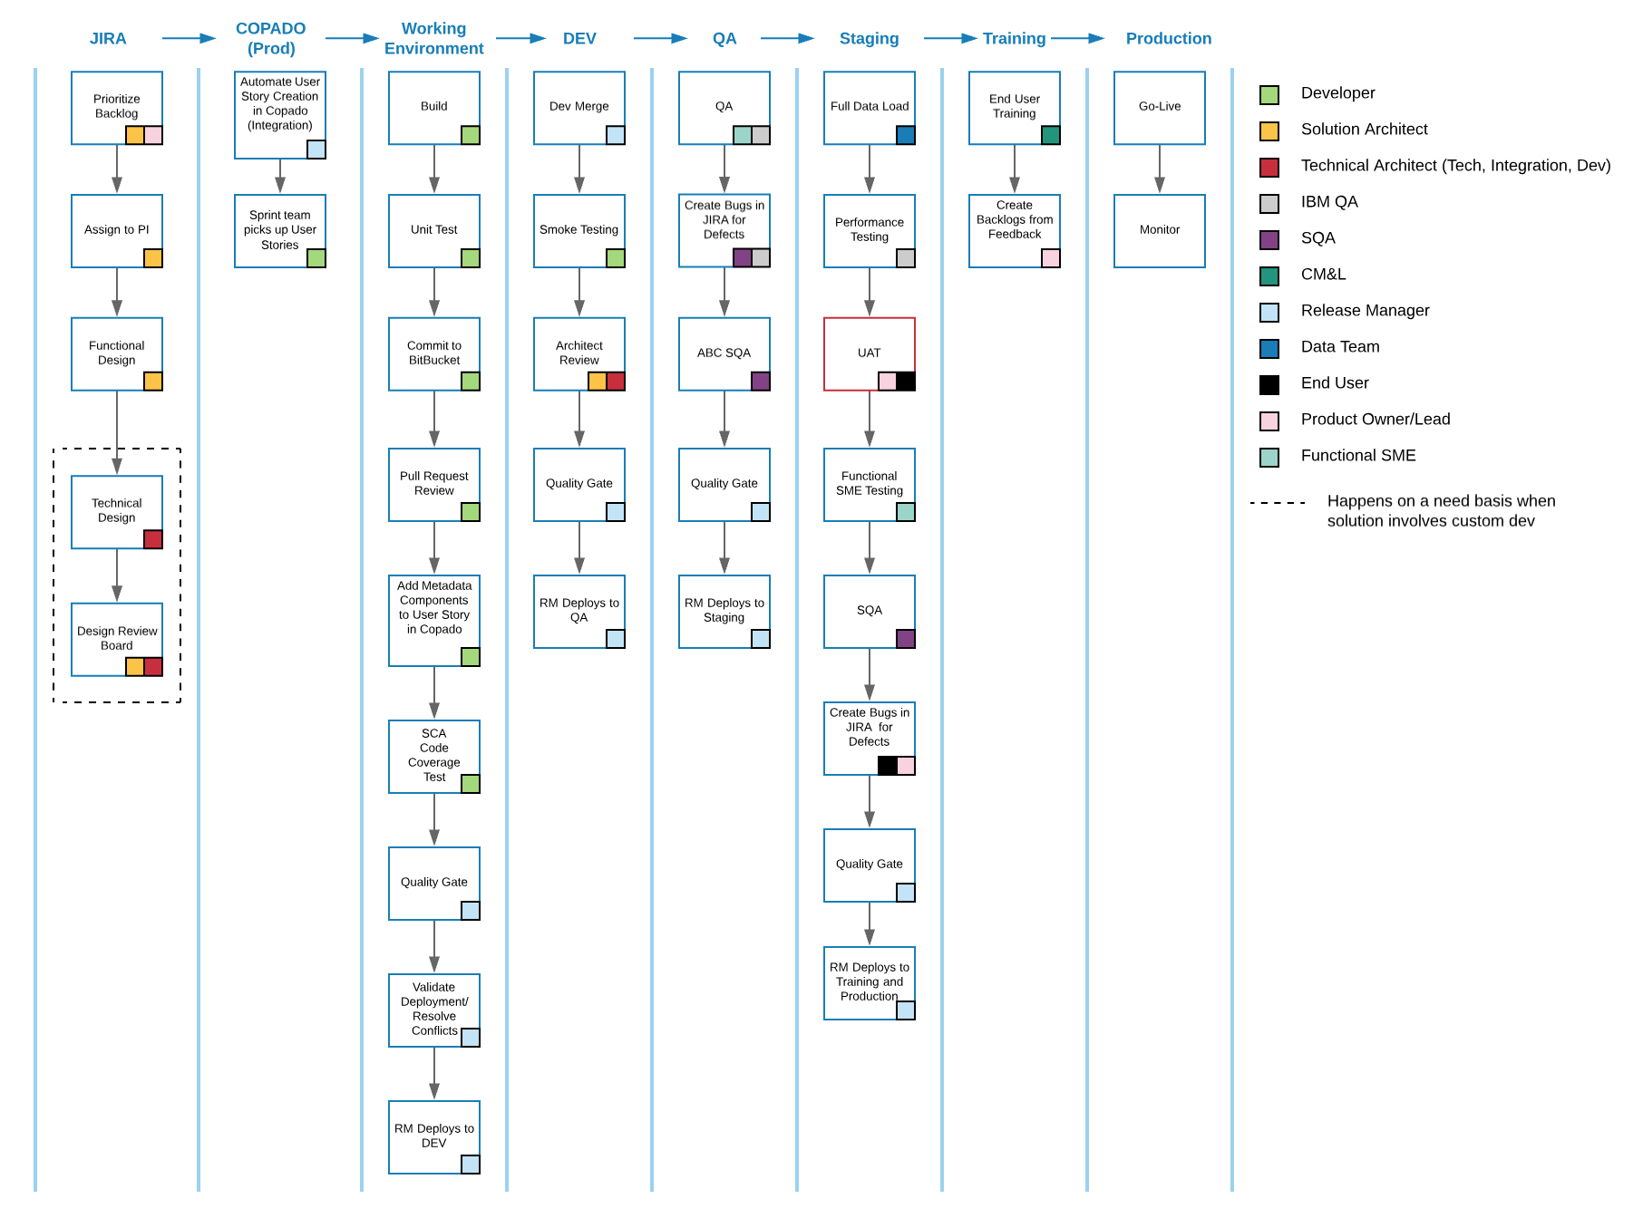
Release Process

Slide 6
Design Board
80/20 - Config vs Code Rule
Stay under 60% of the Governor Limit Threshold
Configuration Score (if less than 100 need review and approval)

Slide 7
Quality Gate
Apex Unit Tests
Static Code Analysis using Apex PMD
Strive for >= 90% Code Coverage
80/20 - Config vs Code Rule
Stay under 60% of the Governor Limit Threshold
Peer Review
Architect Review
Selenium Tests

Slide 8
Environment Access
 | Working Environments | DEV | QA | Staging | Full | Training | Production
Architects/Leads | X | X | X | X | X | X | X *
Developers | X | X | X
Data |  |  |  | X | X | X | X
QA |  |  | X | X
Release Manager | X | X | X | X | X | X | X
Product Owner/Lead |  | X | X | X |  | X | X
End User |  |  |  | X |  | X | X
OCM |  |  |  | X |  | X
* Not all Architects and Leads will have access to production

Slide 9
Salesforce Licenses (To Be Updated)
 | May 19 (DEV/QA) | 1st Jun 19 (DEV/QA) | Jul 19 (DEV/QA) | 31st Aug 19 (DEV/QA) | Sep 19 | Oct 19 | 1st Nov 19
Salesforce Licenses | 22 | 50 |  | 2000
Community Licenses |  | 20 |  |  |  |  | ~4000
Full Sandbox | 1 |  |  | 1 (Total = 2)
Breakdown
Team | Count
IBM Offshore | 20
IBM Onshore | 15
Salesforce | 4
IBM QA | 6
ABC SQA | 3
Infosec | 1
Jen’s Team | 5
Shea’s Team | 5
Buffer | 5
TOTAL | 54
Additional Salesforce Licenses | 54 – 22 = 32
Community Licenses | 20

Slide 10
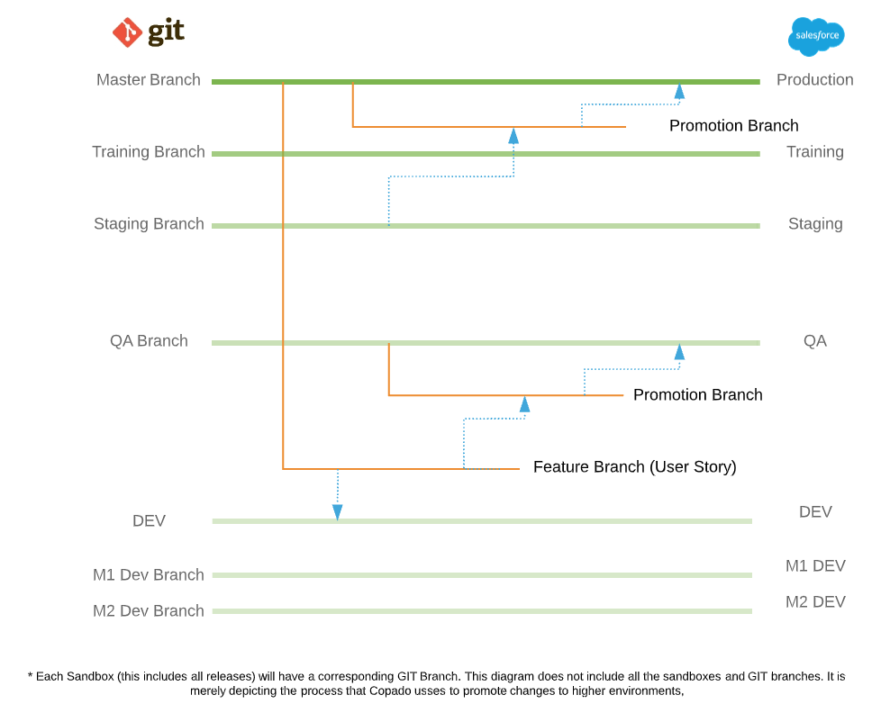
Version Control and Branching Strategy

Slide 11
Next Steps
Copado Setup
BitBucket Repository Setup
JIRA/Copado Integration (Philip Hotz, Derrick McGee)
Prove the Model
Demo

